Slide 1


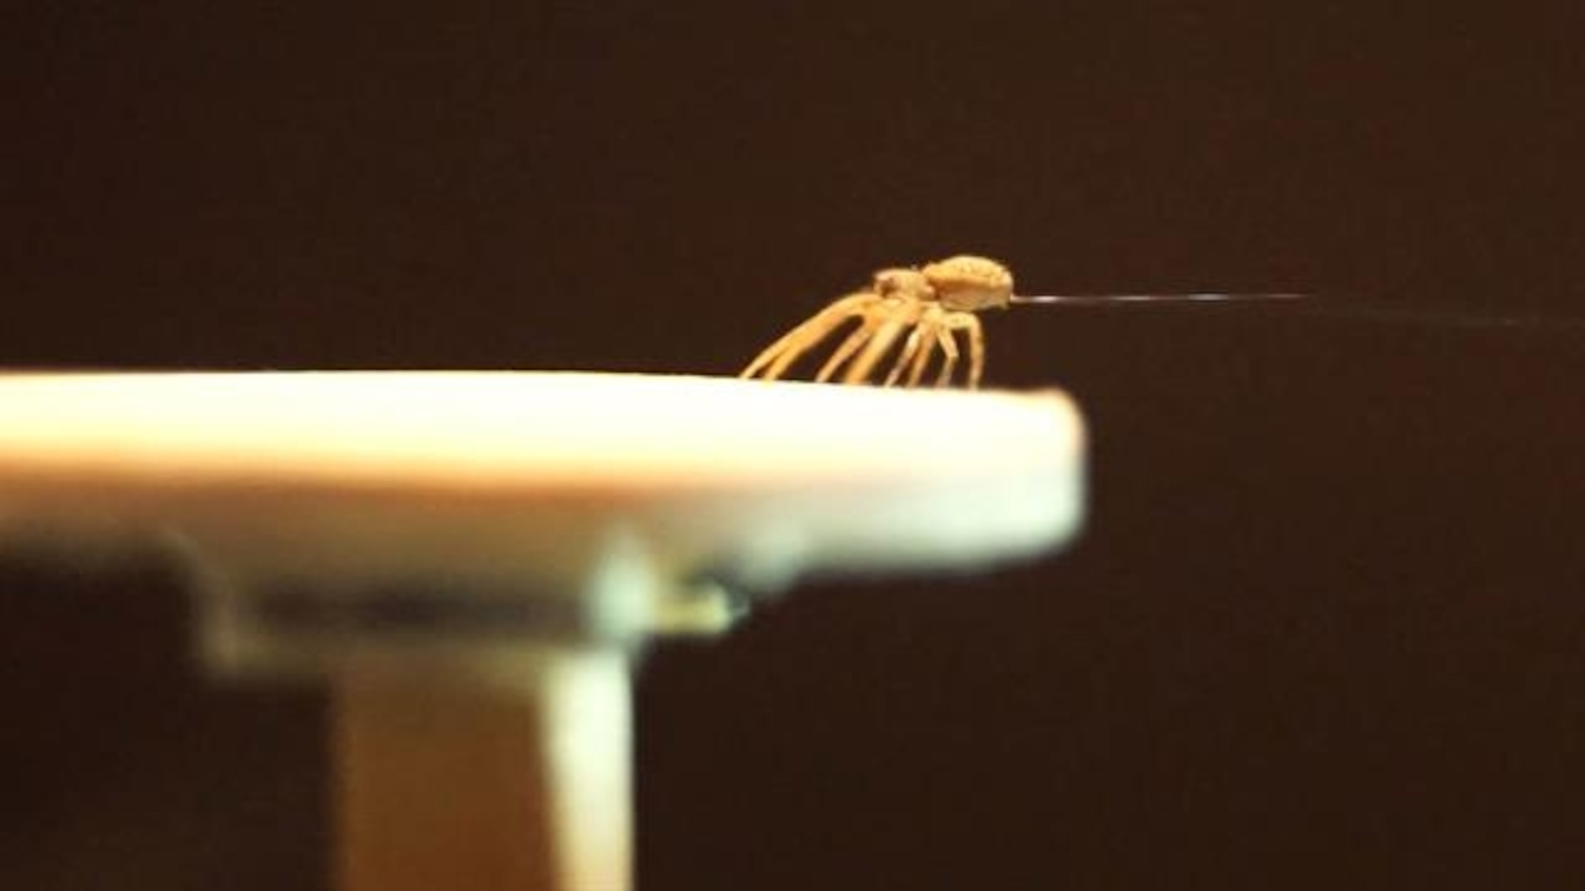
Electrostatic Ballooning of Spiders
Analytical limits and take-off probability

Slide 2
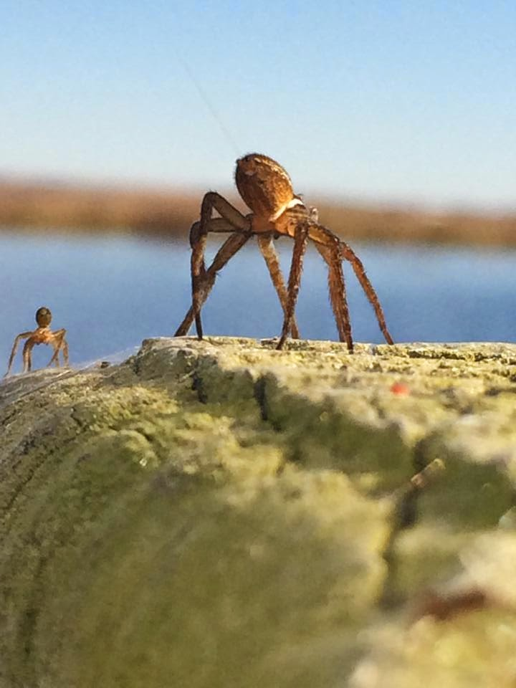
Agenda
A PHYSICAL MODEL
…
B NEAR SURFACE TURBULENCE
…
C ANALITICAL SOLUTION
…
D NUMERICAL METHOD
…
E RESULTS
…

Slide 3
Ballooning of Spiders
Physical Model

Slide 4
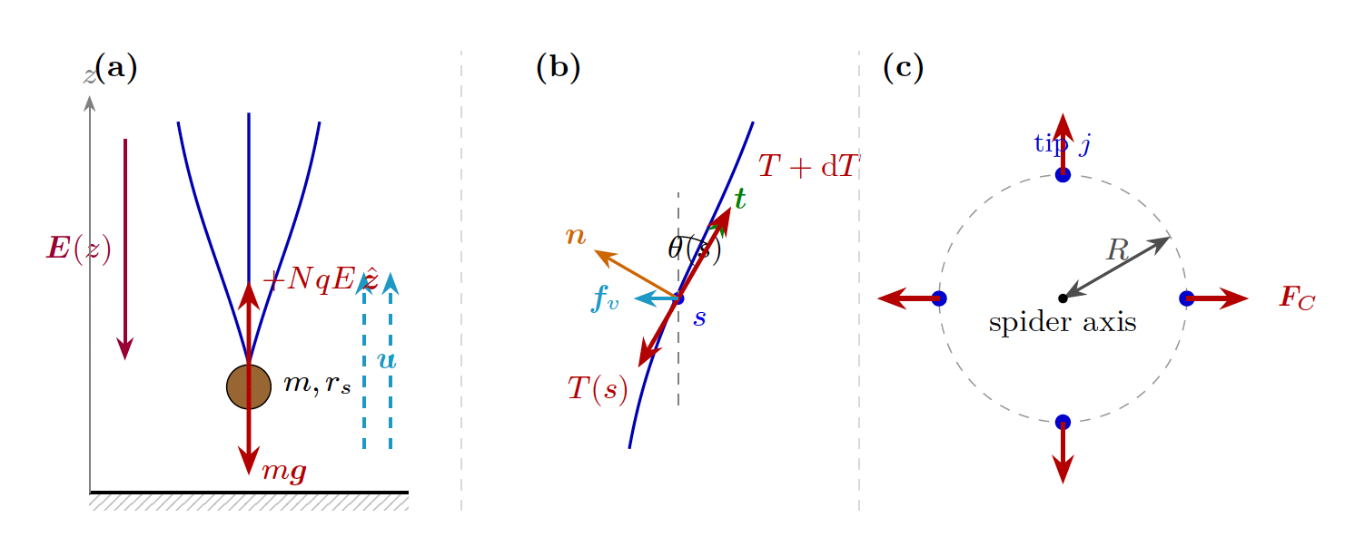
Physical Model
Some text here …

